Slide 1

CSS
http://www.flickr.com/photos/baylorbear78/3406180116/
Cascading sheets of style

Slide 2
Overview
selector { property : value; … }
The selector determines what elements the rule is applied to
Property: The name of a styling property. These names are pre-defined and cannot be invented.
Value: The value for that property. The values are also pre-defined and cannot be invented.
Example:
h1 { font-size: .5em; background-color: blue; }

Slide 3
CSS3 Lengths
Relative units:
em : the current 'font-size'
ex : the height of a lowercase 'x' in the current font
ch : the measure of the zero character glyph
rem : the current font-size of the root element
vw : 1% of the viewport width
vh : 1% of the viewport height
vmin : the smaller of vw and vh
vmax : the larger of vw and vh
Absolute units:
in : 1 inch is equal to 2.54 centimeters
cm : centimeters
mm : millimeters
pt : 1 point is 1/72th of an inch
pc : 1 picas is equal to 12 points or 1/6 of an inch
px : one pixel
q : ¼ of a millimeter

Slide 4
CSS Colors : Name notation
Color values can be specified in multiple ways. The simplest is to refer to a color by name.
CSS3 supports 24-bit RGB colors
8 bits for red, green, and blue (8 more for transparency)
A total of 2^24 = 16,777,216 colors
CSS3 has assigned names to 140 colors
Names range from 'red', 'green', and 'blue' to 'antiquewhite' and dodgerblue'.
Examples:
p { color : red; }
h1 { color : antiquewhite; }
div { color : purple; }

Slide 5
CSS Colors : rgb functional notation
rgb(r, g, b).
The parameters denote the amount of red, green and blue in the color.
The parameters are all either
integers in [0, 100] followed by a percent sign.
integers in [0, 255] such that 255 means 100%
Examples
h1 { color: rgb(100%, 0%, 0%); }
p { color : rgb (255, 0, 0); }
div { color: rgb(38, 238, 99) ; }

Slide 6
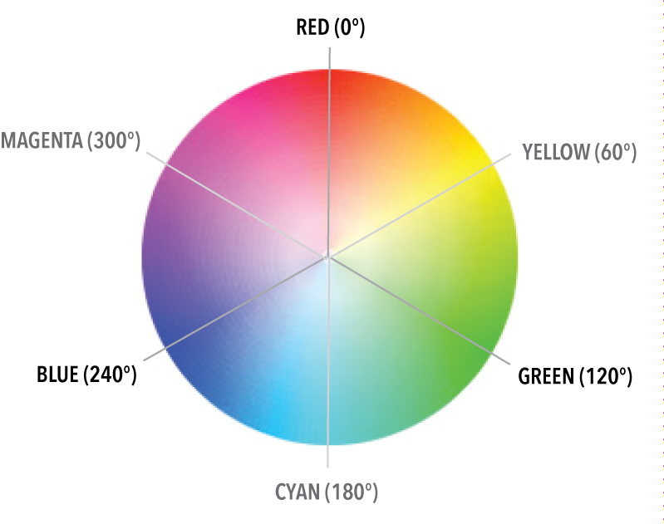
CSS Colors : hsl functional notation
hsl( h, s, l ). The three inputs denote the following
h : the hue of the color. A value in 0 to 360. Denotes an angular measure around the color wheel.
s : the saturation (vividness) of the color. A value in 0 to 100%.
l : the brightness (luminosity). A value in 0 to 100%.
Examples
p { color : hsl(120, 50%, 50%); }
h1 { color : hsl(300, 100%, 25%); }

Slide 7
CSS Colors : Hex notation
Using hex notation, the color is given as three numbers, each of which is written with two hexadecimal (base 16) digits. These digits are sequenced together and preceded by a hash (#) symbol.
Hexadecimal digits: 0,1,2,3,4,5,6,7,8,9,A,B,C,D,E,F
A two digit hex number is converted to decimal by using the formula
16 * (value of first digit) + (value of second digit)
Examples:
#FF0000
#00FF00
If there are only three digits, the browser constructs a six-digit value by repeating each digit.
#FFF => #FFFFFF
#ABC => #AABBCC

Slide 8
CSS Colors :rgba and hsla functional notation
Transparency. The rgb and hsl functional notation can be extended to include a fourth 'transparency' setting.
The transparency is often known as "alpha" and is a value in the range 0 to 1.
An alpha of 1 means not transparent (fully opaque)
An alpha of 0 means fully transparent (not opaque)
Examples
rgba(255, 0, 0, .75)
rgba(0,150,250,.5)
hsla(120,50%,50%,.25)

Slide 9
Color-related properties
Common color-related properties
background-color: the background color of the element
color: the foreground color ( text color ) of the element
border-color: the color of the border (if any)
Example:
p {
background-color: rgb(255, 0, 0);
color: black;
border-color: hsl(25, 50%, 50%)
}

Slide 10
Fonts
A web browser can only use fonts if the font is available. A font becomes available one one of three ways
Embedded in the browser itself
Installed on the computer running the browser
Available on the web (web-font)
Fonts are named. There are two kinds of names:
specific name : the name of a specific font family
Times New Roman
Georgia
Helvetica
generic name : denotes a set of specific fonts. There are 5 generic font families defined in CSS3
serif (e.g., Times New Roman)
sans-serif (e.g., Helvetica)
cursive (e.g., Zapf-Chancery)
fantasy (e.g., Western)
monospace (e.g., Courier)

Slide 11
Font-family
font-family: Specifies which font to use for the selected elements. The value is a prioritized comma-separated list of font names
To select a specific font, the browsers traverses the prioritized list of font-families and selects the first available font
Generic font families are a fallback mechanism. Can preserve some of the style sheets intent when none of the specified fonts is available.
Examples:
body { font-family: Gill, Helvetica, sans-serif; }
Gill and Helvetica: specific font family names
sans-serif: a generic family name.
body { font-family: "New Century Schoolbook", serif }

Slide 12
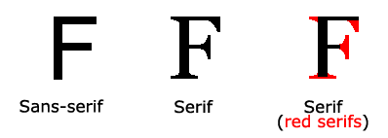


Generic Fonts
Serif : Glyphs tend to have finishing strokes, flared or tapering ends, or have actual serifed endings (including slab serifs). Serif fonts are typically proportionately-spaced. They often display a greater variation between thick and thin strokes than fonts from the 'sans-serif' generic font family.
{ font-family : "Times New Roman", Times, serif; }
Sans-Serif : Glyphs tend to have stroke endings that are plain -- with little or no flaring, cross stroke, or other ornamentation. Sans-serif fonts are typically proportionately-spaced. They often have little variation between thick and thin strokes, compared to fonts from the 'serif' family.
{ font-family : "MS Arial", arial, sans-serif; }

Slide 13

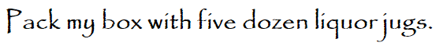

Generic Fonts
Cursive : Glyphs generally have either joining strokes or other cursive characteristics beyond those of italic typefaces. The glyphs are partially or completely connected, and the result looks more like handwritten pen or brush writing than printed letterwork. Fonts for some scripts, such as Arabic, are almost always cursive.
{ font-family : "Zapf-Chancery", "Brush Script Std", cursive; }
Fantasy : Fantasy fonts are primarily decorative while still containing representations of characters (as opposed to Pi or Picture fonts, which do not represent characters.
{ font-family : "Papyrus", fantasy; }
Monospace : The sole criterion of a monospace font is that all glyphs have the same fixed width.
{ font-family : "Courier", monospace; }

Slide 14
Font-Style
font-style: the following values are allowed
normal
italic
oblique
inherit (inherits the style of parent)
What is the difference between italic and oblique?
An oblique is a font that has been skewed a certain number of degrees (8-12 degrees, usually). An italic is created by the type designer with specific characters drawn differently.
Most browsers substitute one for the other if the specified style is missing from the font.

Slide 15

Font-Variant
font-variant: supports the following values
normal : the default
small-caps : uses small caps for lower-case

Slide 16
Font-Weight
font-weight: specifies font thickness. Allowed values are given as
normal, bold
bolder, lighter (one weight bolder, lighter)
100 | 200 | 300 | 400 | 500 | 600 | 700 | 800 | 900
400 is normal and 700 is bold
Examples:
h1 { font-weight: bold; }
h2 { font-weight: 900; }
h3 { font-weight: lighter; }

Slide 17
Font-size
font-size: allowed values are given below
medium (default)
xx-small
x-small
small
large
x-large
xx-large
smaller
larger
length : specified in some unit of measure

Slide 18
line-height
line-height: specifies the minimal height of the line-boxes with the element. The minimum height includes the distance height above and below the baseline.

Slide 19
line-height
line-height: sets the height of each line of text in the element. Does not affect font-size. Line-height values include
normal : default
A length
A non-negative number. The number is interpreted as a scaling-factor on the current font-size
A non-negative percentage.

Slide 20
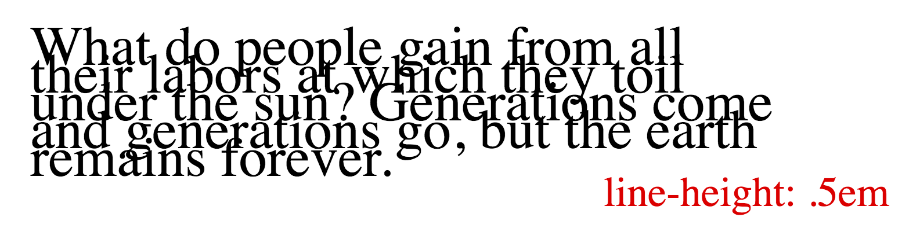
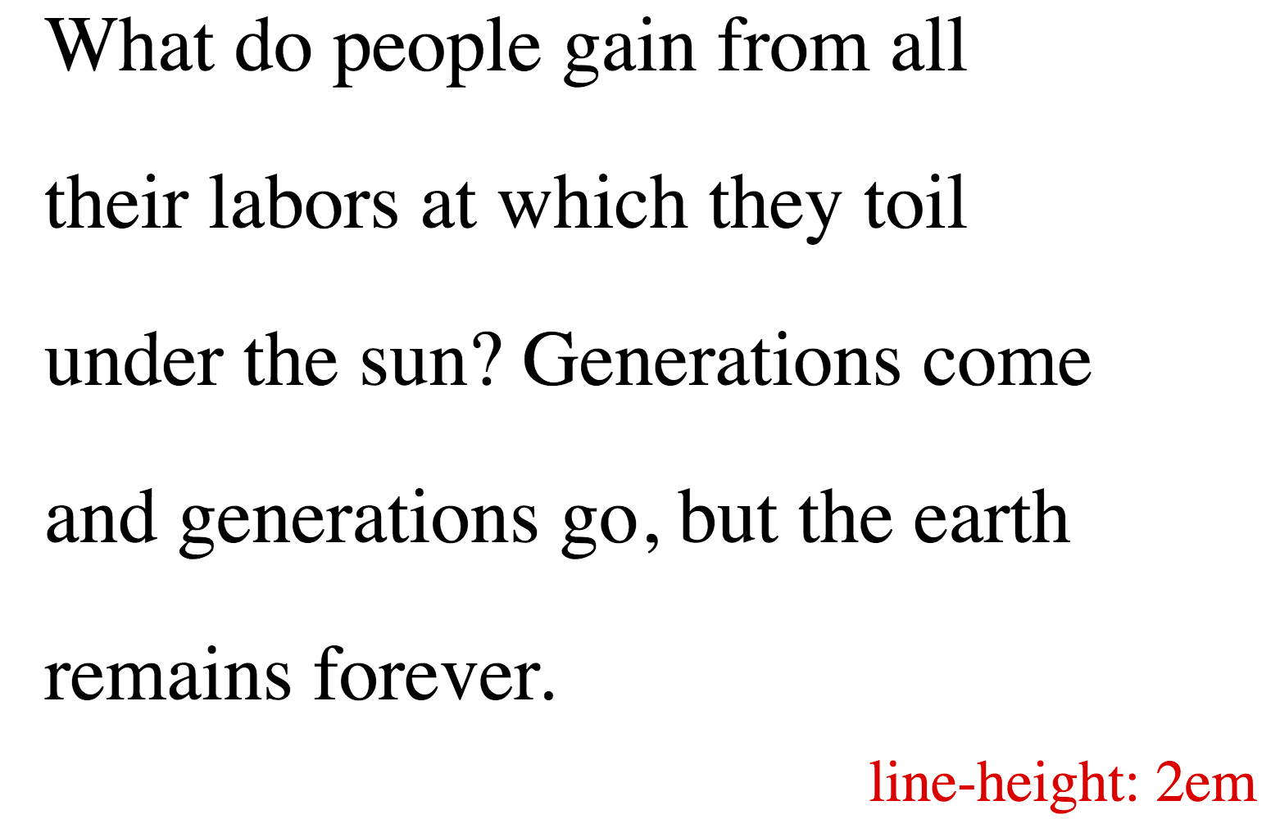
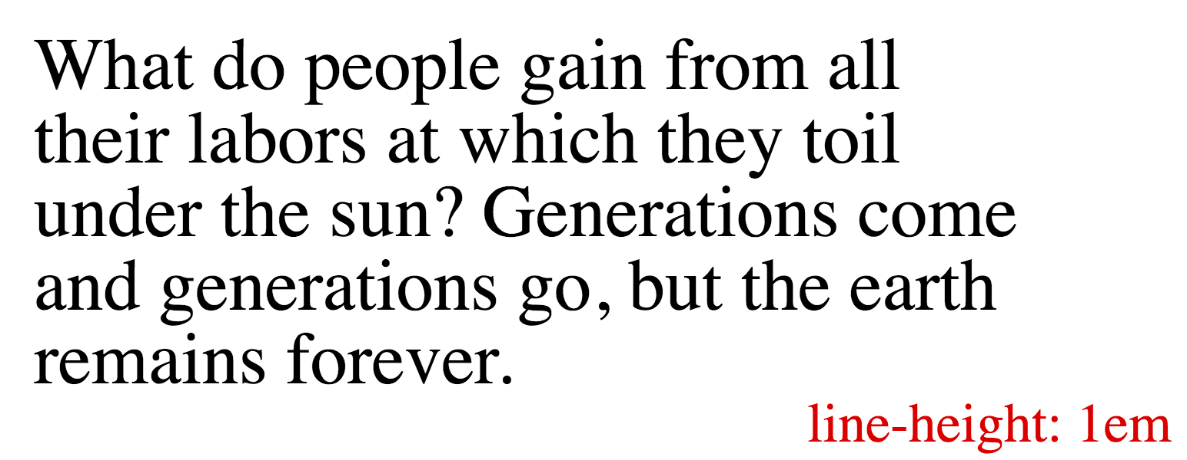
line-height

Slide 21
letter-spacing
letter-spacing: defines the spacing between text characters. Values include
normal – the normal spacing for the current font.
a length. The length indicates the inter-character spacing "in addition to" the default spacing between characters. This means that negative lengths are allowed but there may be implementation-specific limits.
p { letter-spacing : .25em; }
div { letter-spacing: 200%; }
span { letter-spacing: -10%; }

Slide 22
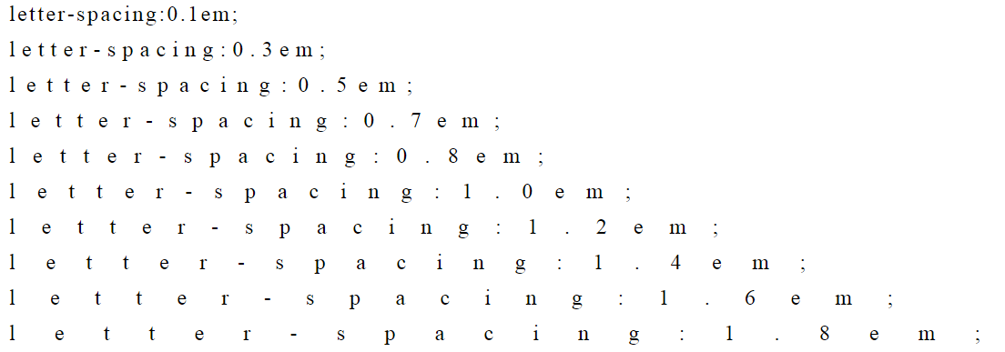
Text : Letter-spacing
letter-spacing: controls the spacing between letters in text. Value is a length or 'inherit' or 'normal'
{ letter-spacing: 1em; }

Slide 23
Fonts
There is a shorthand for specifying all of the font-related properties in one rule.
font: style variant weight size/line-height family
Examples:
p { font : 12px/14px sans-serif }
p { font : 80% sans-serif }
p { font : x-large/110% "New Century Schoolbook", serif }
p { font : bold italic large Palatino, serif }
p { font : normal small-caps 120%/120% fantasy }

Slide 24
@font-face
CSS3 allows for 'at-rules' to be included in a stylesheet. A CSS at-rule is a statement of sorts and not a styling directive.
@font-face defines a web-font that is automatically downloaded and activated when needed.
This expands the choice of fonts beyond the viewing platform.
accessed via HTTP as TrueType, WOFF, EOT or SVG.
Example
@font-face {
font-family : Gentium;
src: url(http://example.com/fonts/Gentium.woff)
}

Slide 25
Google web fonts
Google provides web-fonts for use in web apps. Check out https://www.google.com/fonts
Google provides a stylesheet link that contains @font-face at-rules
Google provides the fonts themselves using any of supported web-font file formats.

Slide 26
Text : Text-Indent
text-indent: A value that is applied to the first-line of text content.
A length followed by an optional [each-line | hanging]. Not supported in most browsers.
each-line : the first-line after a forced line break
hanging : invert the normal meaning
Example:
{ text-indent: 3em; }
{ text-indent: 3em hanging; }
{ text-indent: 40px each-line; }
{ text-indent: 10%; }

Slide 27
Text : Text-align
text-align: controls how inline content is aligned within the parent. It does not control the children. Values include the words
start
end
left
right
center
justify
match-parent
start end

Slide 28
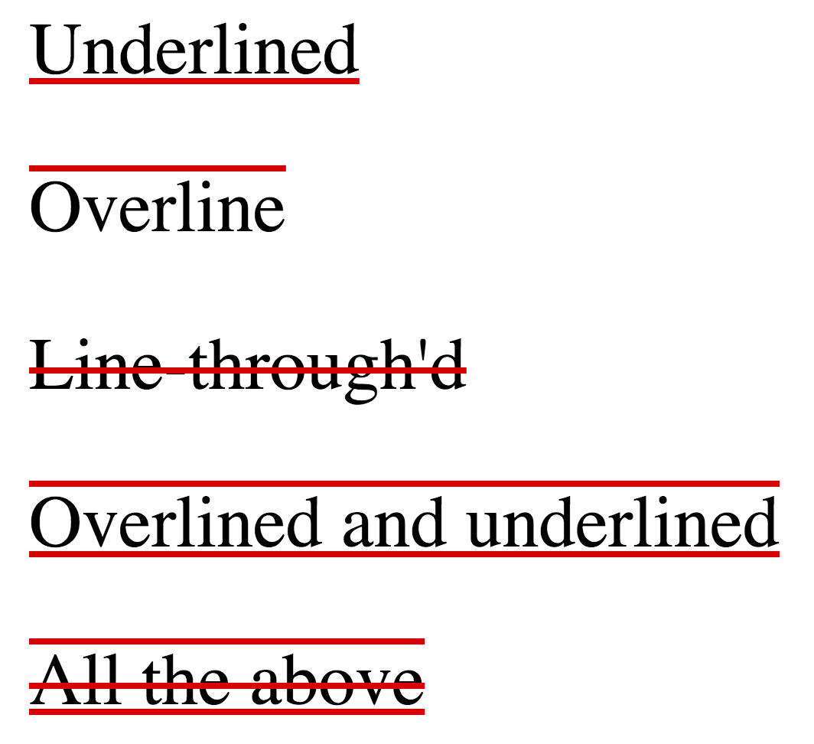
Text : Text-decoration-line
text-decoration-line: allows lines to be drawn relative to text content. Values include the words
none
underline
overline
line-through
Note: If 'none', then no other values are allowed, otherwise can have multiple space-separated values.
Examples:
span.tab { text-decoration-line: underline; }
span.tab.active { text-decoration-line: underline overline; }

Slide 29
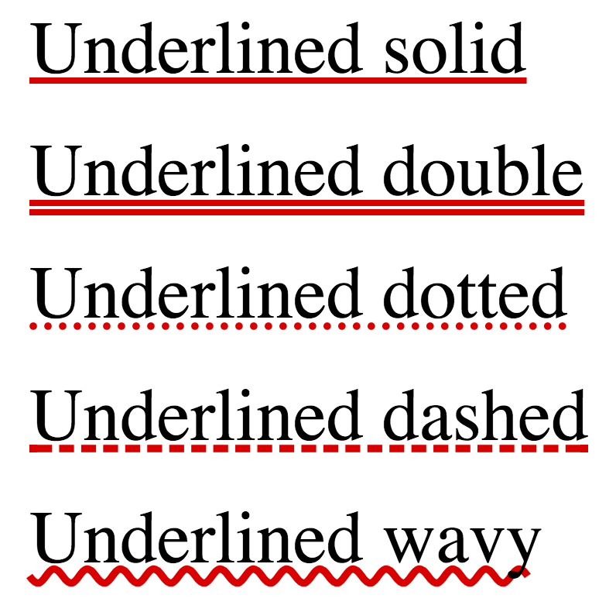
Text : Text-decoration-color
text-decoration-color: specifies the color of the text-decoration (if any).
text-decoration-style: specifies the line style of the text-decoration. Values are given as
solid
double
dotted
dashed
wavy
Note: If 'none', then no other values are allowed, otherwise can have multiple space-separated values.
Examples:
span.tab { text-decoration-line: underline; }
span.tab.active { text-decoration-line: underline overline; }

Slide 30
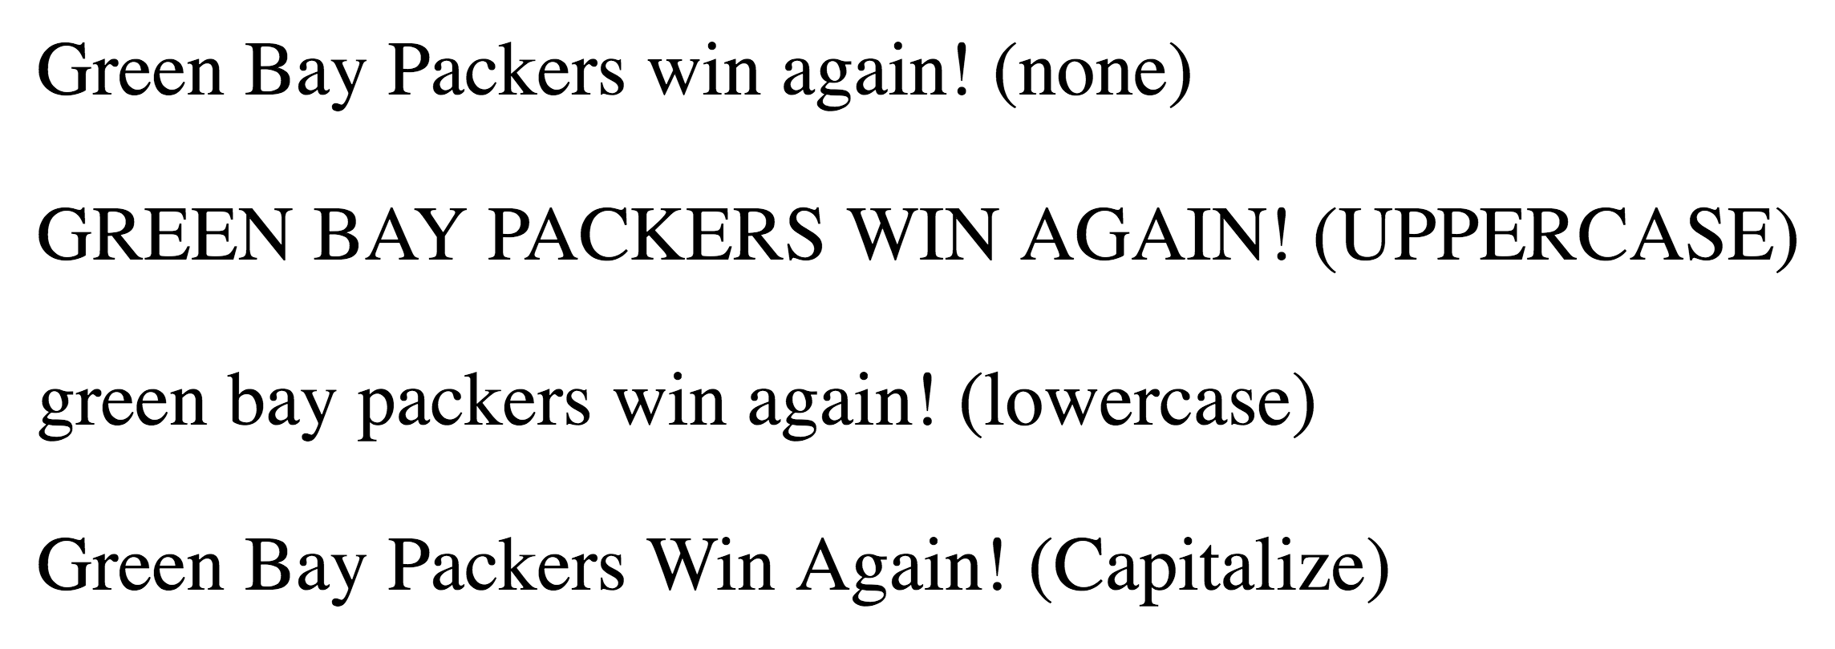
Text : Text-Transform
text-transform: controls the capitalization of text. Regardless of the actual content of an element, it will be rendered in accordance with the values below.
uppercase
lowercase
capitalize
none
Examples:
div { text-transform : uppercase; }
<div>Green Bay Packers Win Again!</div>

Slide 31
Counters
CSS counters allow you adjust the appearance of content based on its location in a document.
Automatically number the headings in a webpage.
Automatically number section headers
Counters are variables managed by CSS rules that allow you to number things in a document.
Counter Properties
counter-reset: <counter-name> <number>
counter-increment: <counter-name> <number>
Counter value
counter( <counter-name > ) : the value of the counter

Slide 32
Content
content: is used to insert content into a document. Supported only in conjunction with a ::before and ::after pseudo-element selector. Supported values are
none
text
a url
counter
Example:
h1::before { content : "Chapter "; }
a::before { content : url(http://www.mozilla.org/favicon.ico); }
div::before { content : counter( divcounter ) ". " }

Slide 33
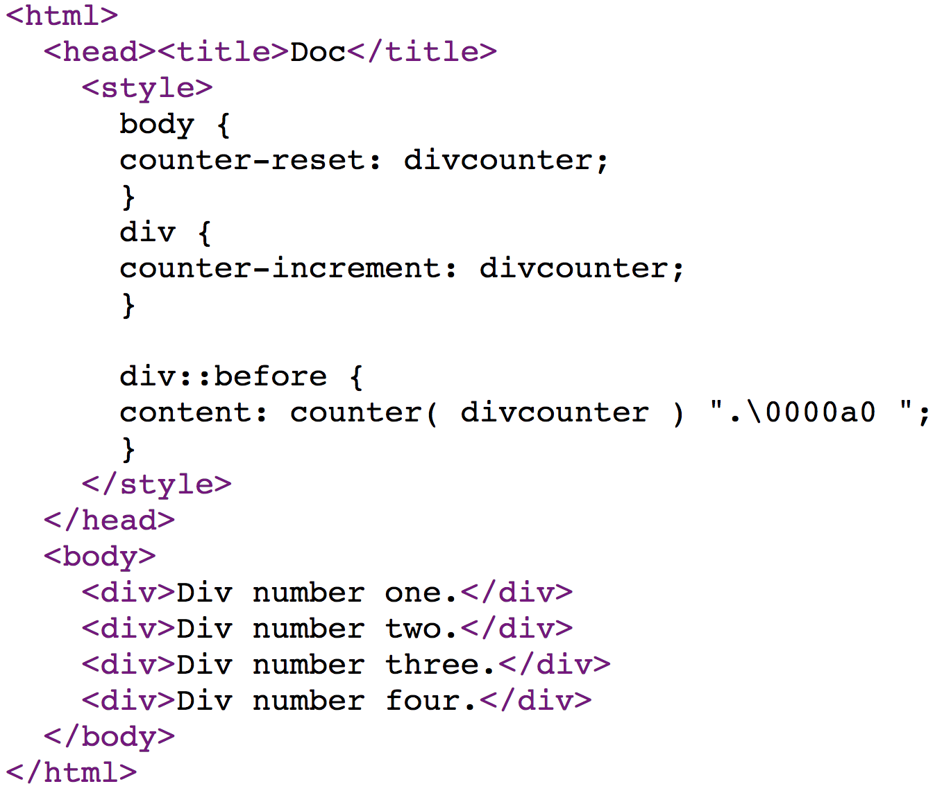
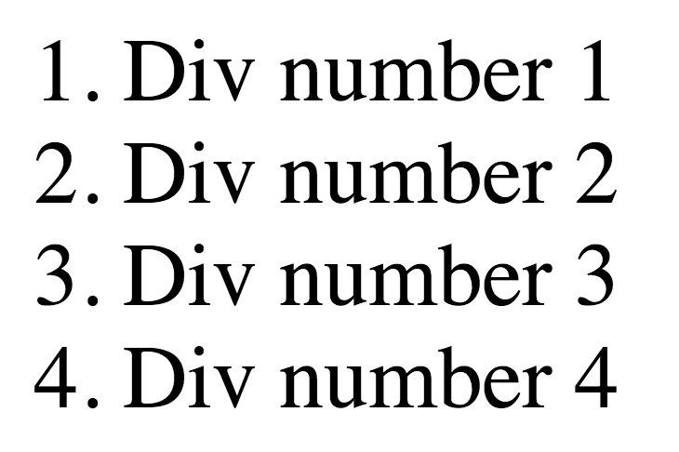
Content & Counter

Slide 34
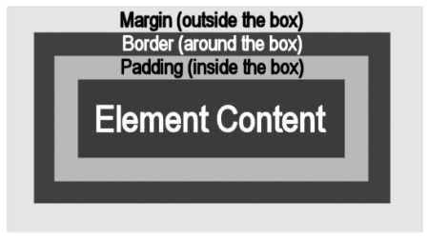
Box Model
Every element is a box.
The margin lies outside the content. The margin is used to separate boxes.
The border (if present) contributes to the overall size.
Padding separates the border from its content
The content is contained in the box.

Slide 35
Margin
Margin settings: each has a length value:
margin-bottom
margin-left
margin-right
margin-top
The ‘margin’ property is shorthand for all four of the above
=> margin-top margin-right margin-bottom margin-left
If there is one parameter, it is applied to all margins
If there are two: the first is applied to top and bottom. The second to left and right
If there are three: The first it top, the second is right and left, the third is bottom

Slide 36
Margin Examples
Examples
body { margin: 2em }
body { margin: 1em 2em }
body { margin: 1em 2em 3em }
The last rule of the example above is equivalent to the example below:
body {
margin-top: 1em;
margin-right: 2em;
margin-bottom: 3em;
margin-left: 2em;
}

Slide 37
Padding
Padding properties : each is a length value
padding-bottom
padding-left
padding-right
padding-top
The ‘padding’ property is shorthand for the above four.
=> padding-top padding-right padding-bottom padding-left
If there is one parameter, it is applied to all padding
If there are two: the first is applied to top and bottom. The second to left and right
If there are three: The first it top, the second is right and left, the third is bottom

Slide 38
Padding Examples
Examples
body { padding: 2em }
body {padding : 1em 2em }
body {padding : 1em 2em 3em }
The last rule of the example above is equivalent to the example below:
body {
padding-top: 1em;
padding-right: 2em;
padding-bottom: 3em;
padding-left: 2em;
}

Slide 39
Borders
The following properties control the border
Width related properties
border-top-width
border-bottom-width
border-right-width
border-left-width:
border : b-t-w, b-r-w, b-b-w, b-l-w
Values: medium, thin, thick, or a length
Style related properties
border-top-style
border-right-style
border-bottom-style
border-left-style
border-style : b-t-s, b-r-s, b-b-w, b-l-s
Values: none, hidden, dotted, dashed, solid, double, …

Slide 40
Borders
The following properties control the border
Color related properties
border-top-color
border-right-color
border-bottom-color
border-left-color
border-color : b-t-c, b-r-c, b-b-c, b-l-c
Values : a color
Shorthands
border-width : sets width of all borders
border-color : sets the color of all borders
border-style : sets the style of all borders
Each of the above accepts 1 to 4 settings, moving clockwise from the top
border => border-width border-style border-color
Applies the given width, style and color to every border
Examples
border : 2px solid red;
border : medium dashed green;

Slide 41
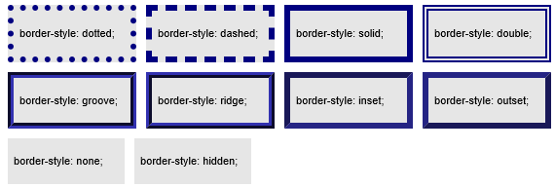
Borders
Border-style has the following values
none,
hidden
dotted
dashed
solid
double groove
ridge
inset
outset

Slide 42
Borders
Examples
p { border: solid red; }
p { border-width-top: 3em; border-top-style:dashed; }
p {
border-top: solid red;
border-right: solid red;
border-bottom: solid red;
border-left: solid red;
border-image: none;
}

Slide 43
Rounded Borders
Borders can be rounded. Each of the following take two values: a percentage or length.
border-top-right-radius
border-top-left-radius
border-bottom-right-radius
border-bottom-left-radius
The two values define the radii of a quarter ellipse that defines the shape of the corner of the outer border edge
the first value is the horizontal radius
the second the vertical radius.
If either length is zero, the corner is square, not rounded.
Percentages for either radius refer to the relevant dimension (width/height) of the border box

Slide 44
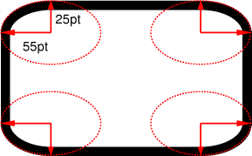
Example
The two values of ‘border-top-left-radius: 55pt 25pt’ define the curvature of the corner.
Example: <div style="box-sizing:border-box;width:600px;height:400px;border-color:black;border-style:solid;border-width:2px;border-radius:100px 400px 50px 400px;"/>

Slide 45
list styling
list-style-type: specifies the appearance of an LI marker
disc / circle /square
decimal / decimal-leading-zero
lower-roman / upper-roman
lower-greek / upper-greek
lower-alpha / upper-alpha
none

Slide 46
Rendering/Layout
When a browser renders an element, the browser needs to know
The width of the elements box
The height of the elements box
The position (x, y) of the elements box
The process of determining these things (for every element) is known as ”layout”. Layout is complex and is entangled with numerous CSS properties including
display
position
top/left/right/bottom
width/height
float
clear

Slide 47
Width and Height
The width and height of an element are normally computed by
Laying out the children (i.e. determine their widths, heights and positions)
Computing margin, padding and border
The width and height can be explicitly controlled (not computed)
width and height are CSS properties with length units
Examples:
img.logo { width: 10%; }
p {height: 15px; }
h1 {width: 33%; height: 2.5 em; }
Note that width and height have no effect on inline elements
span { width : 50%; height: 100px; } /* ignored unless the span has elsewhere been declared ‘block level’ */

Slide 48
Min/Max Width/Height
The width and height can be constrained with the following CSS properties
min-width
max-width
min-height
max-height
Examples:
p { width: 50%; max-width: 680px; }
p { height : 800px; min-height : 300px; }

Slide 49
Display Property
The display property controls how the browser lays out an element. Common values (there are others)
inline : elements are arranged horizontally and wrap inside the parent
block : elements are arranged vertically; one above the other
inline-block : the element is arranged internally as a block but is layed-out itself as an inline.
flex : a block-level flex container
inline-flex : an inline-level flex container
list-item : The element generates a block-box for the content and a separate list-item inline box.
none : the element is not displayed. The element has a width and height of zero.

Slide 50

Display:none and Visibility:hidden
Visibility controls whether or not an element can be seen. Values include:
visible : The element is visible
hidden : The element is invisible. It still occupies screen space.
Note:
display:none, the element has zero width and height.
visibility:hidden, the elements height and width are the same as being visible.

Slide 51
Position
Position is a CSS property that selects rules for element layout.
static :
default : causes normal layout rules to apply
top, left, right, and bottom properties do not apply
Elements with static position are “not positioned”.
relative :
All elements are layed out using the static rules.
The boxes position is then offset by amounts determined by the top, left, right, and bottom properties.
fixed :
Position the element (using top/bottom/left/right) relative to the viewport
Don't move it when the page is scrolled.
Don't reserve space for it
absolute:
Position the element (using top/bottom/left/right) with respect to it's nearest positioned ancestor
Don’t reserve space for it

Slide 52
General idea of block/inline
A
A
B
B
C
C
block
inline inline/block
Normal flow (illustrated generally above)
position is ’static’ or ‘relative’
flow is ‘none’
Floats:
flow is other than ‘none’
Absolute positioning:
position is ‘fixed’

Slide 53
top, bottom
The top CSS property specifies part of the position of positioned elements.
no effect on non-positioned elements.
absolute/fixed position elements: specifies the distance between the top margin edge of the element and the top edge of its containing block.
relatively positioned elements: specifies the amount the element is moved below its normal position.
When both top and bottom are specified, as long as height is unspecified, auto or 100%, both top and bottom distances will be respected. Otherwise, if height is constrained in any way, the top property takes precedence and the bottom property is ignored.

Slide 54
left,right
The right CSS property specifies part of the position of positioned elements.
no effect on non-positioned elements
absolute/fixed elements : specifies the distance between the right margin edge of the element and the right edge of its containing block.
relative : specifies the amount by which the element is offset from the left or right of its non-positioned position.
When both the right CSS property and the left CSS property are defined, the position of the element is overspecified. In that case, the left value has precedence when the container is left-to-right and the right value has precedence when the container is right-to-left

Slide 55
Floating
The 'float' property controls an alternative layout mechanism.
When present, this property takes the element out of normal flow and positions the element at either the left-most or right-most available position within it's container. Text and other inline elements wrap around it.
Supported values:
left, right, none
The 'clear' property is something of a float reset.
When a floating element is ‘cleared’, there can be no floating element on the ‘cleared’ side
Supported values:
left, right, both, none

Slide 56
OVERFLOW
Specifies whether to clip content, render scrollbars or other. Supported values include
visible : (default) Content is not clipped and it may render outside of the parent box
hidden : content is clipped and no scrollbars
scroll : content is clipped and scrollbars appear as needed
auto : the browser chooses what to do
Only applied to block-level elements that have a bound on their height (i.e. height or max-height property set) OR has white-space property set to nowrap.
https://css-tricks.com/video-screencasts/42-all-about-floats-screencast/

Slide 57
white-space
The white-space property controls how whitespace is handled. Supported values:
normal :
sequences of whitespace are collapsed
nowrap :
sequences of whitespace are collapsed
No line-breaks are created by the browser.
pre :
sequences of whitespace are preserved
pre-wrap :
sequences of whitespace are preserved
lines are broken at newline characters, <br> elements, and wherever the browser needs to wrap.
pre-line :
sequences of whitespace are collapsed
lines are broken at newline characters, <br> elements, and wherever the browser needs to wrap

Slide 58
Background settings
CSS background properties are used to define the background effects of an element.
background-color
background-image
background-repeat:
repeat-x: tiled horizontally
repeat-y: tiled vertically
repeat: tiled horizontally and vertically (default)
no-repeat
background-attachment
scroll: background scrolls with the viewport (default)
fixed: background doesn't scroll
background-position
[left | center | right ] [ top | center | bottom]
Shorthand
background: color image repeat attachment position

Slide 59
Examples
Background-image
body { background-image: url("marble.png") }
p { background-image: none }
Background-repeat and attach
body {
background: red url("pendant.png");
background-repeat: repeat-y;
background-attachment: fixed;
}
Background-attach
body { background: url("banner.jpeg") right top } /* 100% 0% */
body { background: url("banner.jpeg") top center } /* 50% 0% */
body { background: url("banner.jpeg") center } /* 50% 50% */
body { background: url("banner.jpeg") bottom } /* 50% 100% */
Background
BODY { background: red }
P { background: url("chess.png") gray 50% repeat fixed }

Slide 60
Outline
Elements may be outlined. The outline doesn't 'count' in terms of altering the width or the height of the element. The outline is independent of border, margin, padding.
For example, to draw a thick black line around an element when it has the focus, and a thick red line when it is active, the following rules can be used:
:focus { outline: thick solid black }
:active { outline: thick solid red }

